Slide 1

Operating System (O.S)
Lect-6

Slide 2
Operations on Process
The processes in most systems can execute concurrently, and they may be created and deleted dynamically. Thus, these systems must provide a mechanism for process creation and termination.
Process Creation
Process Termination

Slide 3
Process Creation
During the course of execution, a process may create several new processes
The creating process is called a parent process, and the new processes are called the children of that process. Each of these new processes may in turn create other processes, forming a tree of processes.
Most operating system identify processes according to a unique process identiﬁer (pid), which is typically an integer number.
The pid provides a unique value for each process in the system
It can be used as an index to access various attributes of a process within the kernel.
When a process creates new process, two possibilities for execution exist:
The parent continues to execute concurrently with its children.
The parent waits until some or all of its children have terminated.
There are also two address-space possibilities for the new process:
The child process is a duplicate of the parent process (it has the same program and data as the parent).
The child process has a new program loaded into it.

Slide 4
Process Creation
Resource sharing
Parent and children share all resources
Children share subset of parent’s resources
Parent and child share no resources
Execution
Parent and children execute concurrently
Parent waits until children terminate
Address space
Child duplicate of parent
Child has a program loaded into it

Slide 5
System call during Process Creation
Fork() System call
A new process is created by the fork() system call.
The new process consists of a copy of the address space of the original process.
This mechanism allows the parent process to communicate easily with its child process.
Exec() system call
It replace the process’s memory space with a new program.
The exec() system call loads a binary ﬁle into memory and starts its execution.
In this manner, the two processes are able to communicate and then go their separate ways. The parent can then create more children; or, if it has nothing else to do while the child runs

Slide 6
Wait() system call
if it has nothing else to do while the child runs, it can issue a wait() system call to move itself off the ready queue until the termination of the child.
Because the call to exec() overlays the process’s address space with a new program, the call to exec() does not return control unless an error occurs.
Exit() system call.
The parent waits for the child process to complete with the wait() system call. When the child process completes it invoking exit() , the parent process resumes from the call to wait(), where it completes using the exit() system call.

Slide 7
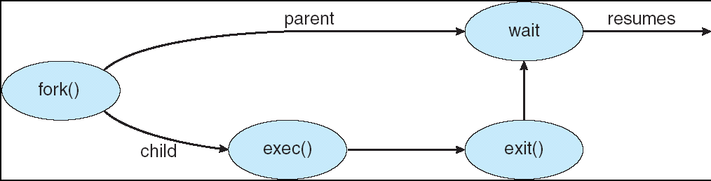

Slide 8
Process Termination
A process terminates when it ﬁnishes executing its last statement and asks the operating system to delete it exit() System call
Output data from child to parent (via wait)
Process’ resources are deallocated by operating system
Parent may terminate execution of children processes (abort)
Child has exceeded allocated resources
Task assigned to child is no longer required
If parent is exiting, Some operating system does not allow a child to continue if its parent terminates.

Slide 9
Inter process Communication
Processes executing concurrently in the operating system may be either independent processes or cooperating processes.
Independent processes
A process is independent if it can not affect or be affected by the other processes executing in the system.
Any process that does not shared at a with any other process is independent
Cooperating processes
A process is cooperating if it can affect or be affected by the other processes executing in the system.
Any process that shares data with other processes is a cooperating process.

Slide 10
Cooperating processes
There are several reasons for providing a n environment that allows process cooperation:
Information sharing.
Since several users may be interested in the same piece of information (for instance, a shared ﬁle), we must provide an environment to allow concurrent access to such information.
Computation speed up.
If we want a particular task to run faster, we must break it into sub tasks, each of which will be executing in parallel with the others. Notice that such a speedup can be achieved only if the computer has multiple processing cores.
Modularity.
We may want to construct the system in a modular fashion, dividing the system functions into separate processes or threads,
Convenience.
Even an individual user may work on many tasks at the same time. For instance, a user may be editing, listening to music, and compiling in parallel.

Slide 11
Cooperating processes
Cooperating processes require an inter process communication (IPC) mechanism that will allow them to exchange data and information.
There are two fundamental models of inter process communication:
Shared memory
In the shared-memory model, a region of memory that is shared by cooperating processes is established. Processes can then exchange information by reading and writing data to the shared region.
Message passing.
In the message-passing model, communication takes place by means of messages exchanged between the cooperating processes.

Slide 12
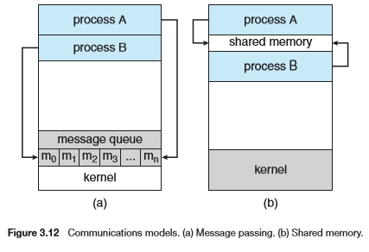

Slide 13
Inter process Communication (IPC)
Mechanism for processes to communicate and to synchronize their actions
Message system – processes communicate with each other without resorting to shared variables
IPC facility provides two operations:
send(message) – message size fixed or variable
receive(message)
If P and Q wish to communicate, they need to:
establish a communication link between them
exchange messages via send/receive
Implementation of communication link
physical (e.g., shared memory, hardware bus)
logical (e.g., logical properties)

Slide 14
Direct Communication
Processes must name each other explicitly:
send (P, message) – send a message to process P
receive(Q, message) – receive a message from process Q
Properties of communication link
Links are established automatically
A link is associated with exactly one pair of communicating processes
Between each pair there exists exactly one link
The link may be unidirectional, but is usually bi-directional

Slide 15
Indirect Communication
Messages are directed and received from mailboxes (also referred to as ports)
Each mailbox has a unique id
Processes can communicate only if they share a mailbox
Properties of communication link
Link established only if processes share a common mailbox
A link may be associated with many processes
Each pair of processes may share several communication links
Link may be unidirectional or bi-directional

Slide 16
Synchronization Communication
Communication between processes takes place through calls to send() and receive() primitives.
Message passing may be either blocking or non blocking— also known as synchronous and asynchronous.
Blocking send. The sending process is blocked until the message is received by the receiving process or by the mailbox.
Non blocking send. The sending process sends the message and resumes operation.
Blocking receive. The receiver blocks until a message is available.
Non blocking receive. The receiver retrieves either a valid message or a null.

Slide 17
Buffering
When the communication is direct or indirect, messages exchanged by communicating processes reside in a temporary queue. Basically, such queues can be implemented in three ways:
Zero capacity. The queue has a maximum length of zero; thus, the link cannot have any messages waiting in it. In this case, the sender must block until the recipient receives the message.
Bounded capacity. The queue has ﬁnite length n; thus, at most n messages can reside in it. If the queue is not full when a new message is sent, the message is placed in the queue (either the message is copied or a pointer to the message is kept), and the sender can continue execution without waiting. The link’s capacity is ﬁnite, however. If the link is full, the sender must block until space is available in the queue.
Unbounded capacity. The queue’s length is potentially inﬁnite; thus, any number of messages can wait in it. The sender never blocks.

